Slide 1
ArcGIS Basics
Research Computing Services
May 21, 2019
Dennis Milechin, P.E.
help@scc.bu.edu

Slide 2
Outline
Lecture
What is GIS?
GIS Theory
Geographic coordinate system
Projections
Spatial data types
Attributes
ESRI ArcGIS
Hands On Portion

Slide 3
What is GIS?
Geographic Information System
“A geographic information system (GIS) is a system designed to capture, store, manipulate, analyze, manage, and present spatial or geographic data”
https://en.wikipedia.org/wiki/Geographic_information_system

Slide 4
GIS Theory – Geographic Coordinate System

Slide 5
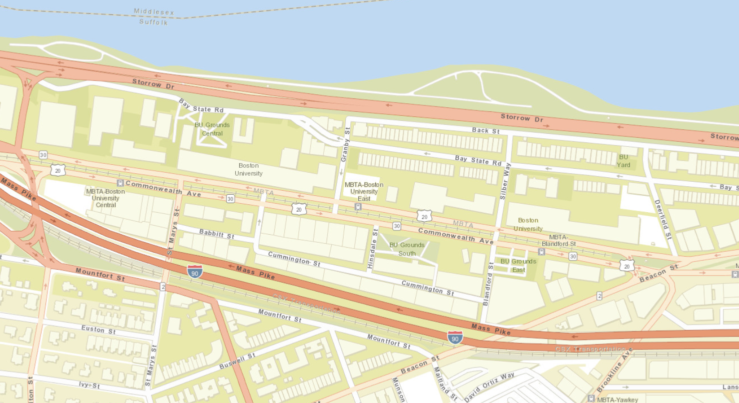
GIS Theory – Geographic Coordinate System
How do I tell a computer where we are located on earth?
We are here!
(42.348287 N, 71.101146 W)

Slide 6
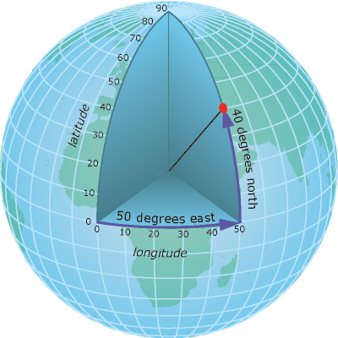
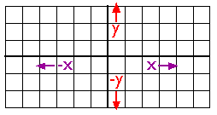
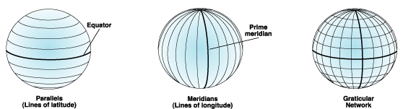
GIS Theory – Geographic Coordinate System
Cartesian Coordinate System
(50 E, 40 N)
Point (2,2)
https://www.e-education.psu.edu/natureofgeoinfo/c2_p10.html
Geographic coordinate system.
http://desktop.arcgis.com/en/arcmap/10.3/guide-books/map-projections/geographic-coordinate-system.htm
Defined by a math model.
http://desktop.arcgis.com/en/arcmap/10.3/guide-books/map-projections/about-geographic-coordinate-systems.htm
http://desktop.arcgis.com/en/arcmap/10.3/guide-books/map-projections/about-geographic-coordinate-systems.htm

Slide 7
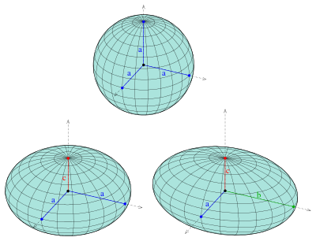
GIS Theory – Geographic Coordinate System
Very complicated topic.
There are many Geographic Coordinate Systems.
There are spherical/ellipsoidal approximation of Earth.
They are updated occasionally.
North American Datum (NAD)
NAD 27
NAD 83 (with 5 updates)
New Datum in 2022!
https://en.wikipedia.org/wiki/Ellipsoid
http://desktop.arcgis.com/en/arcmap/10.3/guide-books/map-projections/about-geographic-coordinate-systems.htm

Slide 8
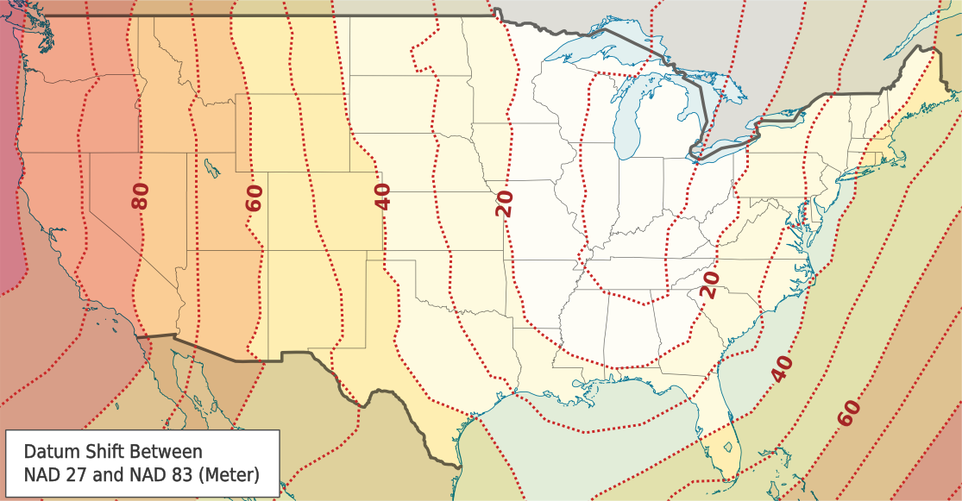
GIS Theory – Geographic Coordinate System
(42.348287, -71.101146)
Could be off by 40 to 45 meters!
https://en.wikipedia.org/wiki/North_American_Datum#/media/File:Datum_Shift_Between_NAD27_and_NAD83.png
http://desktop.arcgis.com/en/arcmap/10.3/guide-books/map-projections/about-geographic-coordinate-systems.htm

Slide 9
GIS Theory – Projections

Slide 10
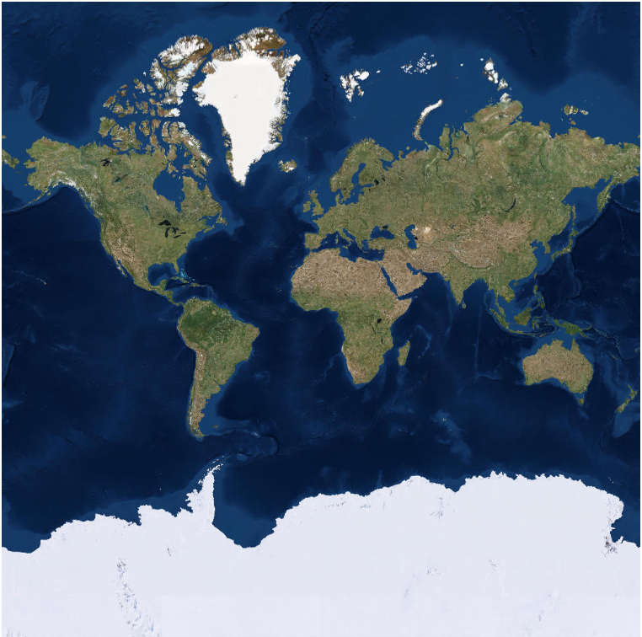
GIS Theory - Projections
Greenland
What is wrong with this map?
Country | Area ( mi ^2)
Africa | 11,730,000
Antarctica | 5,405,000
Greenland | 836,300
Africa
Antarctica

Slide 11
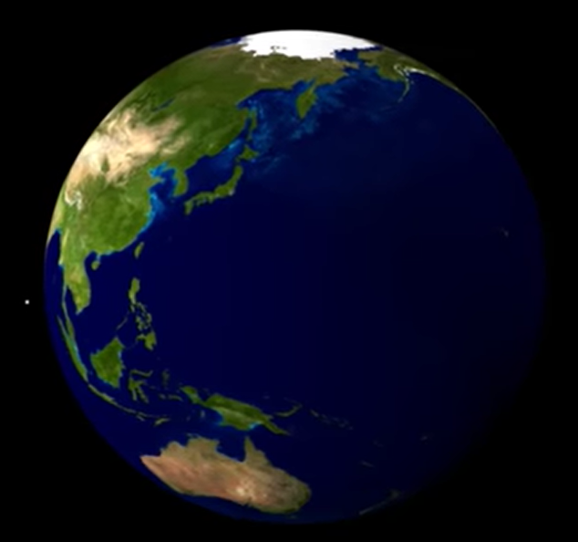
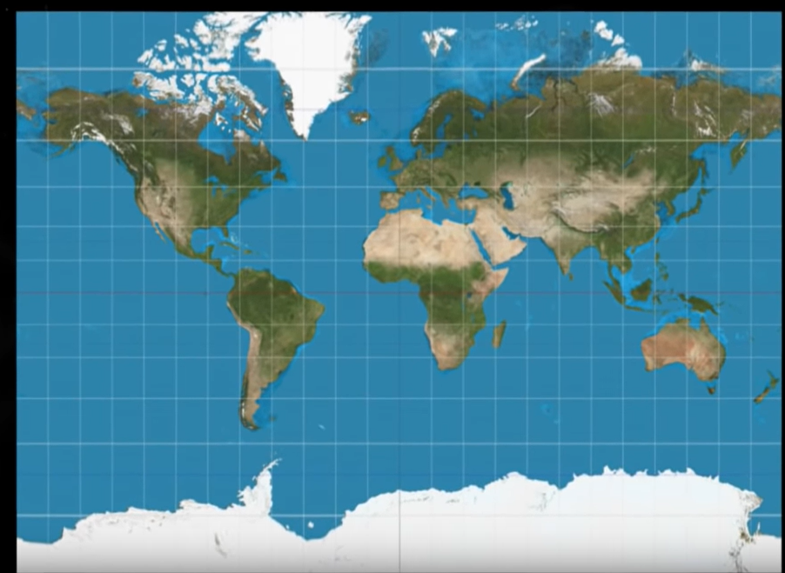
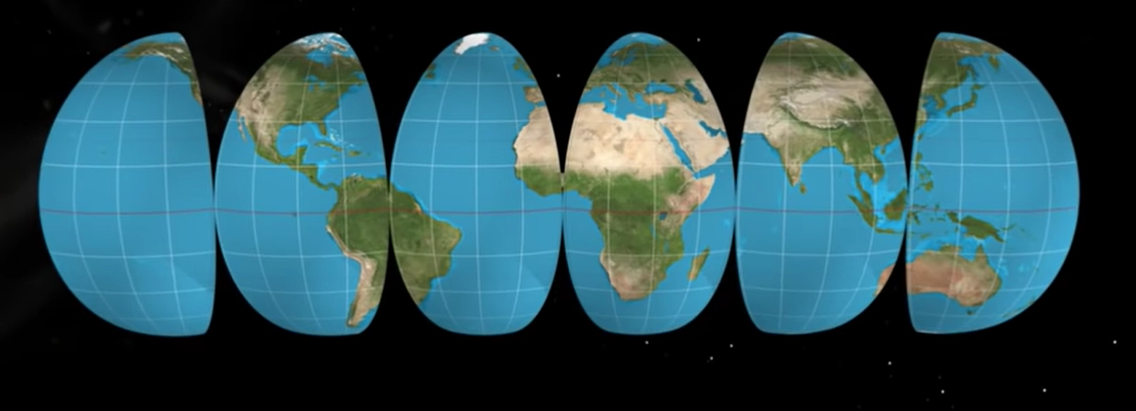
GIS Theory - Projections
https://www.youtube.com/watch?v=CPQZ7NcQ6YQ
https://laughingsquid.com/world-mercator-projection-map-country-size/

Slide 12
GIS Theory - Projections
- Projections allow us to create 2D maps of our Earth.
- Depending on the projection it will distort
- Shape
- Area
- Direction
- Distance

Slide 13
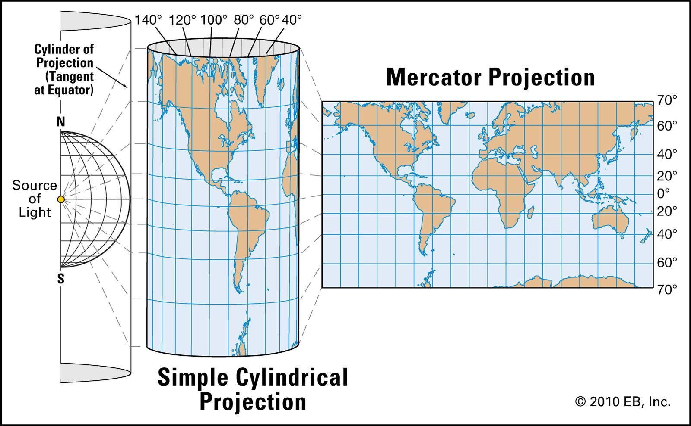
GIS Theory - Projections
Geographic Coordinate System
Projection
http://desktop.arcgis.com/en/arcmap/10.3/guide-books/map-projections/geographic-coordinate-system.htm
https://www.britannica.com/science/Mercator-projection/media/375638/231099

Slide 14
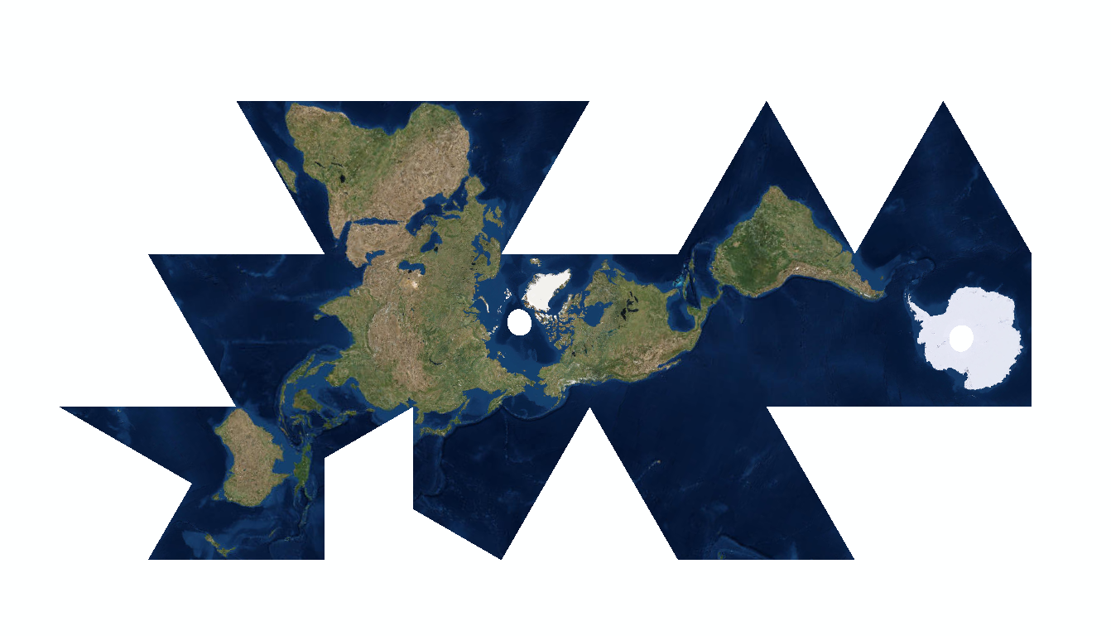
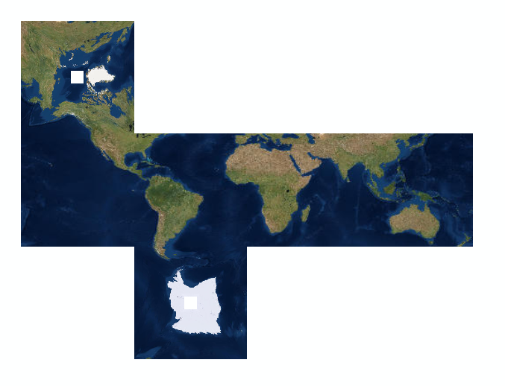
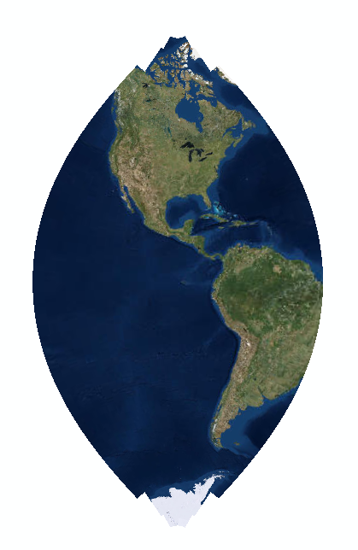
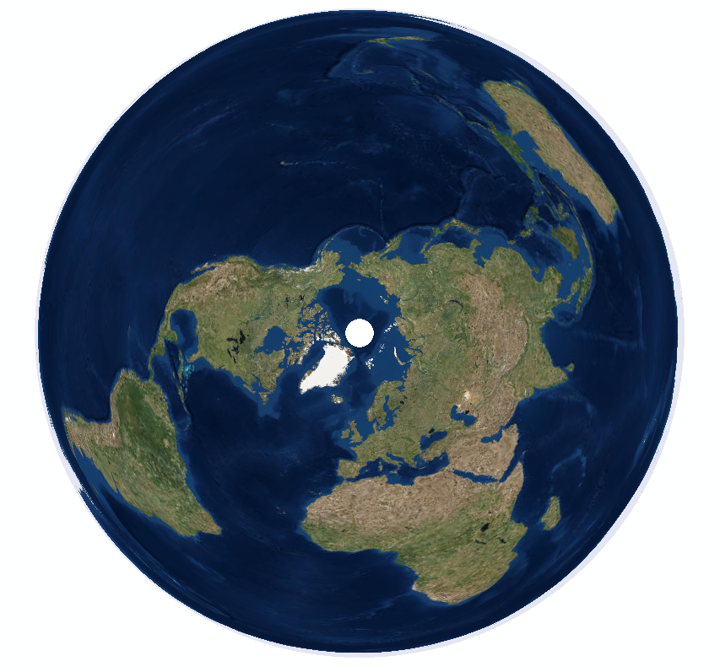
GIS Theory - Projections
World Fuller
Cube World
Polar NSIDC EASE Grid North
NAD 1983 UTM Zone 15N

Slide 15
GIS Theory
GIS software implements most of the GIS theory for us. Phew!
Why do you need to care?
Certain GIS tools require geographic coordinate system and projection to be the same for all inputs.
Georeferencing images or old maps.
When receiving data, like a CSV file with coordinates, make sure you know the geographic coordinate system and projection!
http://desktop.arcgis.com/en/arcmap/10.3/guide-books/map-projections/about-geographic-coordinate-systems.htm

Slide 16
GIS Theory
Geographic coordinate system and projections.
To learn more:
https://www.e-education.psu.edu/natureofgeoinfo/c2.html

Slide 17
GIS Theory – Spatial Data Types

Slide 18
GIS Theory – Spatial Data types
Spatial
Data Types
Vector
Raster

Slide 19

GIS Theory – Spatial Data Types
Vector
(X, Y)
Points
Polylines
Polygon
Note: Each type of vector data is put in its own group when stored. Example, a Points Shapefile will only have points data, no polylines or polygons.

Slide 20
GIS Theory – Spatial Data types
Spatial
Data Types
Vector
Raster

Slide 21
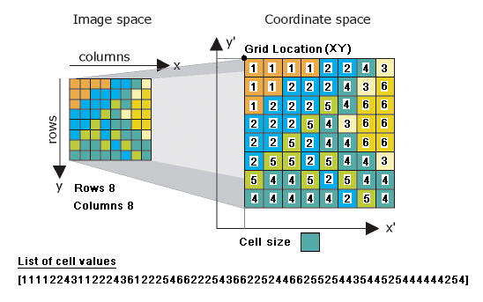
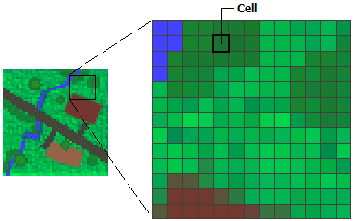
GIS Theory – Spatial Data Types
Raster Data – continuous data
Raster Spatial Properties
Origin
Cell Location
Cell Size
http://desktop.arcgis.com/en/arcmap/latest/manage-data/raster-and-images/what-is-raster-data.htm
http://desktop.arcgis.com/en/arcmap/10.3/manage-data/geodatabases/raster-basics.htm

Slide 22
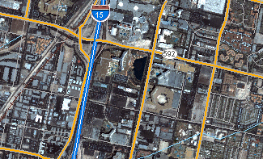
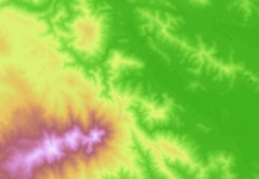
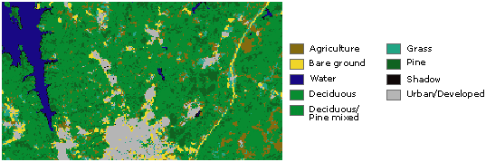
GIS Theory – Spatial Data Types
Examples of Raster Data
http://desktop.arcgis.com/en/arcmap/latest/manage-data/raster-and-images/what-is-raster-data.htm

Slide 23
GIS Theory – Spatial Data Types
Spatial
Component
Raster
Vector
Points
Polylines
Polygon

Slide 24
GIS Theory – Attributes

Slide 25
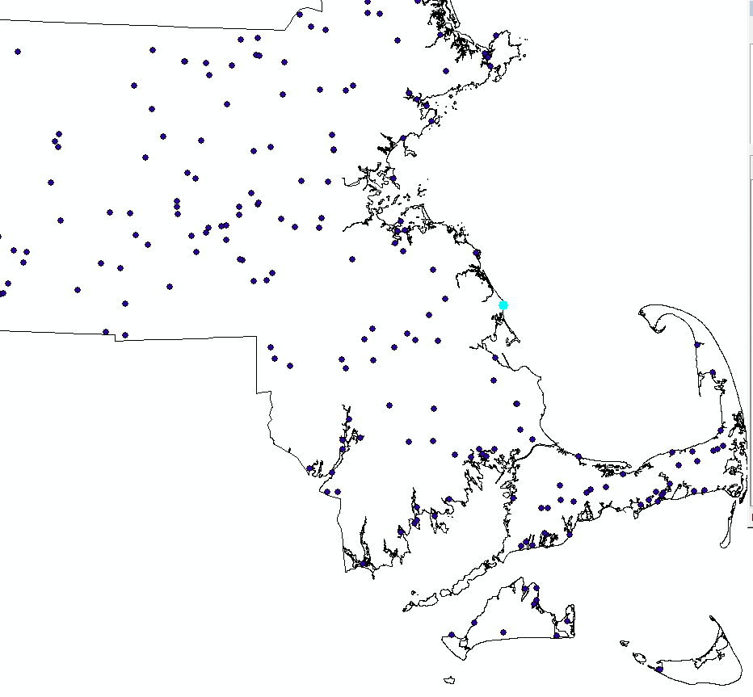
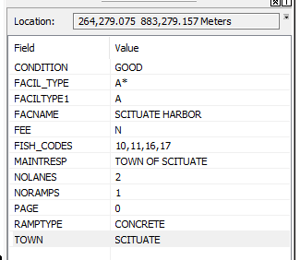
GIS Theory - Attributes
Spatial Component
Attribute Component
(x, y)

Slide 26
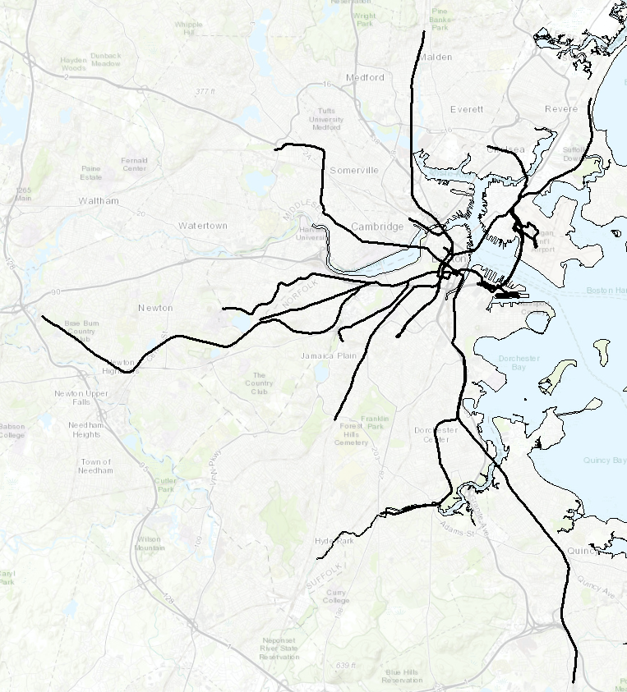
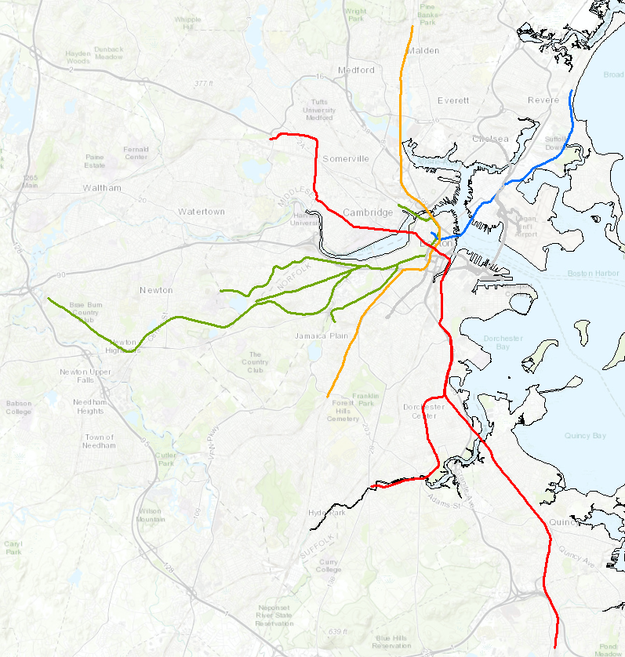
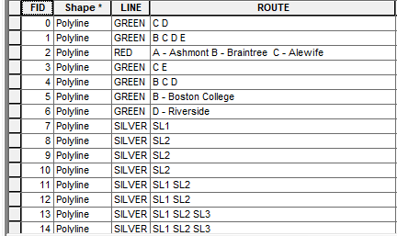
GIS Theory - Attributes
What can we do with attribute data in a map?

Slide 27
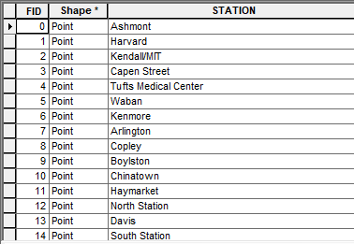
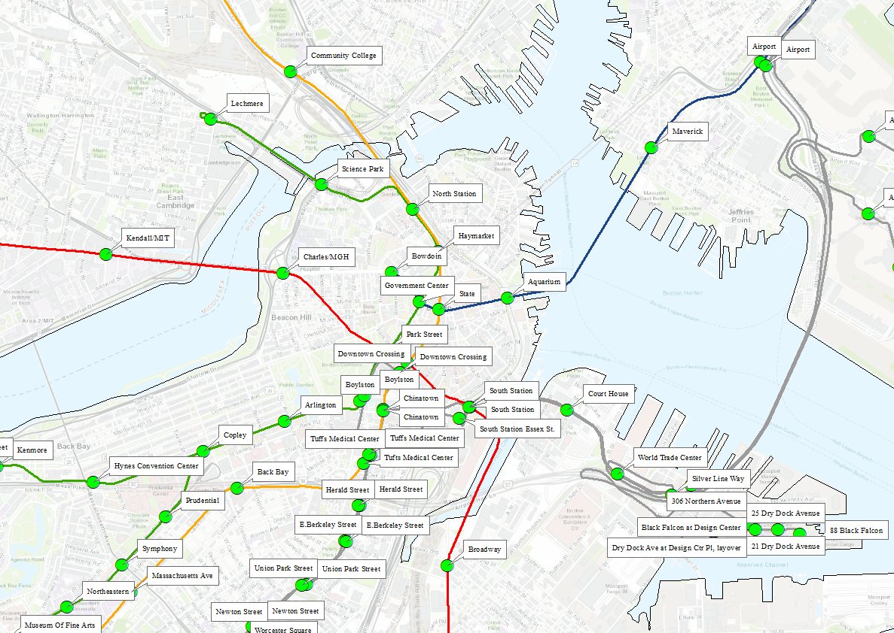
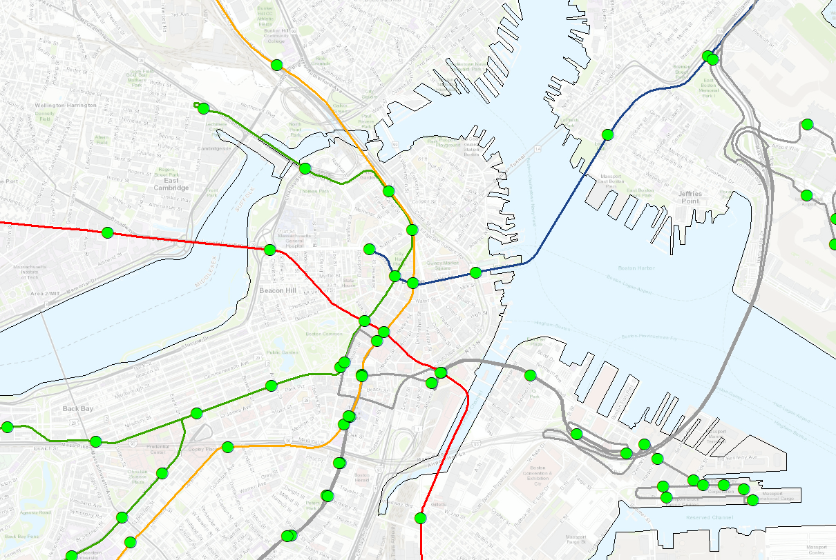
GIS Theory - Attributes
What can we do with attribute data in a map?

Slide 28
ESRI ArcGIS Desktop

Slide 29
ESRI – ArcGIS Desktop
Environmental Systems Research Institute
Products:
ArcGIS Desktop
ArcGIS Pro
ArcGIS Online
ArcGIS Enterprise
This Tutorial

Slide 30
ESRI ArcGIS Desktop
Where can I get ArcGIS Desktop?
CAS IT manages the license
Software only works on Windows machines.
Free for CAS Students, Faculty, Staff
$125 per year for others.
Submit a ticket requesting the software.
http://www.bu.edu/casit/
CAS Building computer labs 327 and 330 have ArcGIS installed.
Alternative – QGIS (https://www.qgis.org/)

Slide 31
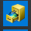



ESRI – ArcGIS Desktop
ArcGIS – Packages
ArcCatalogue
ArcGlobe
ArcMap
This Tutorial
ArcScene

Slide 32
ESRI – ArcGIS Desktop
Typical Workflow
Collect field data with coordinates, or download it.
https://www.mass.gov/service-details/massgis-data-layers
Clean the data
Import data into ArcMap.
Use ArcMap to visualize the data in map form.
Use ArcMap Toolboxes to do spatial analysis.
Create map showing the results.
Share the map/results with others. Maybe via webmap.
This Tutorial

Slide 33
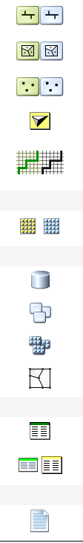
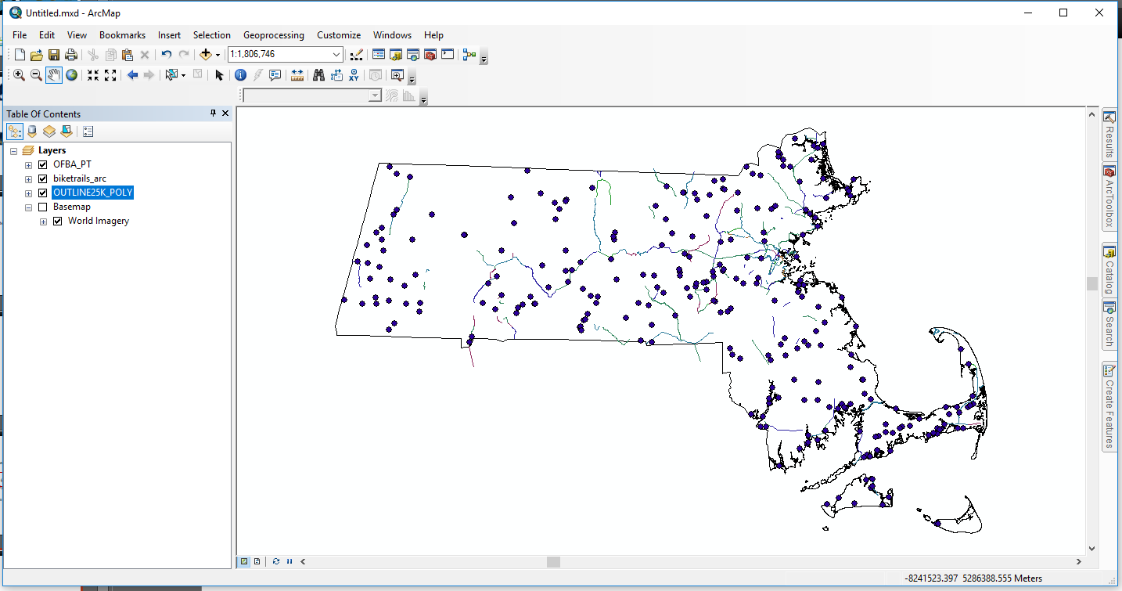
ESRI ArcGIS Desktop
Polyline Shapefile
Polygon Shapefile
Point Shapefile
TIN
Network Dataset
Raster
Geodatabase
Feature Dataset
Raster Dataset
Topology
Excel Table
Other Table Types
Key Concept: ArcMap is a data viewer and not a spatial database.
Text File
https://learngis.org/ArcGIS_File_Icons

Slide 34
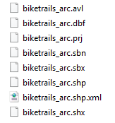
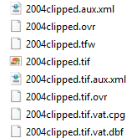
ESRI ArcGIS Desktop
Shapefile
Raster - TIF
These additional files contain geographic coordinate system and projections for the spatial data.
- All files must be kept together!
- All files must have the same name before the file extension!

Slide 35
ESRI – ArcGIS Desktop
Resources Available to You
Official ESRI ArcMap manual.
http://desktop.arcgis.com/en/arcmap/latest/map/main/mapping-and-visualization-in-arcgis-for-desktop.htm
Getting Started With GIS ( Free 3 Hr Tutorial)
https://www.esri.com/training/catalog/57630434851d31e02a43ef28/getting-started-with-gis/
Lesson Galleries of specific applications of GIS
https://learn.arcgis.com/en/gallery/

Slide 36
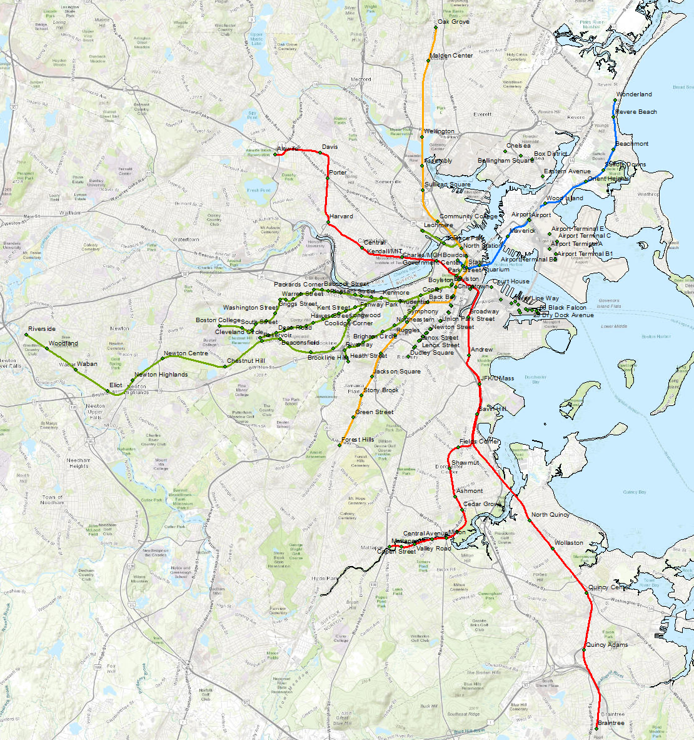
Let’s Open ArcMap!
http://rcs.bu.edu/examples/arcgis/hands_on.docx

